Slide 1
Templates
ThanhNT

Slide 2
Templates
Function templates
Function template instances
Template classes
Expression parameters
Template specialization
Class template specialization
Partial template specialization

Slide 3
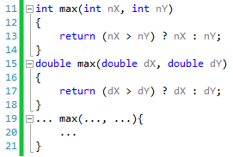
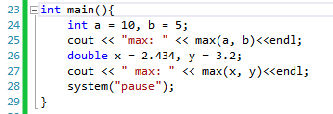
Why need function templates?
Because of C++’s requirement that you specify the type of all parameters. you’re stuck writing one function for each type you wish to use.
Writing one version of max() that was able to work with parameters of ANY type => Function templates

Slide 4
What is a function template?
Function templates are functions that serve as a pattern for creating other similar functions.
The basic idea behind function templates is to create a function without having to specify the exact type(s) of some or all of the variables. Instead, we define the function using placeholder types, called template type parameters.

Slide 5
Creating function templates
FunctionTemplate
Template < TemplateParamList >
FunctionDefinition
TemplateParamDeclaration: placeholder
class
typename

Slide 6
Example function templates
template<class T >
T max( T x, T y )
{
return (x > y) ? x : y;
}
Template parameter
(class, user defined type, built-in types)
Template argument
To output the traced values, we insert:
Cout<< “max:”<int>(3, 5);
Cout<< “max:”<float>(3.2, 5.6);

Slide 7
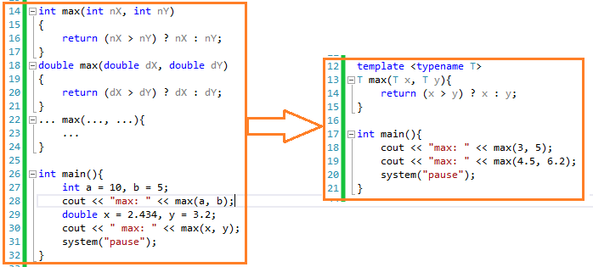
Function templates vs normal function

Slide 8

What is function template instance?
C++ does not compile the template function directly. Instead, at compile time, when the compiler encounters a call to a template function, it replicates the template function and replaces the template type parameters with actual types! The function with actual types is called a function template instance:
1. Compiler encounters a call to the templated function
2. The compiler says, “oh, we want to call max(int, int)”. The compiler replicates the function template and creates the template instance max(int, int):
This is now a “normal function” that can be compiled into machine language

Slide 9
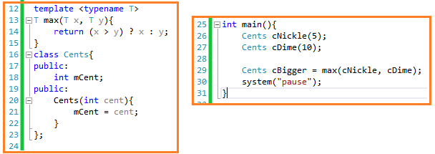

Function template instance
Template functions will work with both built-in types (eg. char, int, double, etc…) and classes
Any operators or function calls in your template function must be defined for any types the function template is instantiated for
C++ will create a template instance for max() that looks like this:

Slide 10
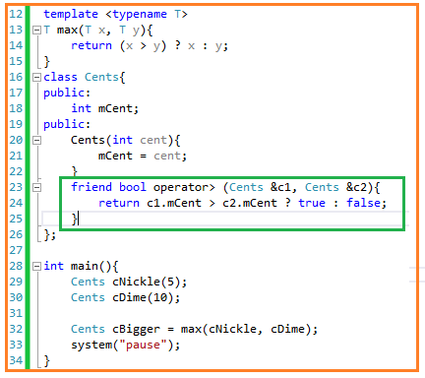
Function template instance(Cont)
See the problem here? C++ has no idea how to evaluate x > y! Consequently, this will produce a compile error.
To get around this problem, overload the > operator for any class we wish to use max() with:

Slide 11
Template classes
Template classes are classes that serve as a pattern for creating other similar classes.
Class Template
Template < TemplateParamList >
ClassDefinition
TemplateParamDeclaration: placeholder
class
typename

Slide 12
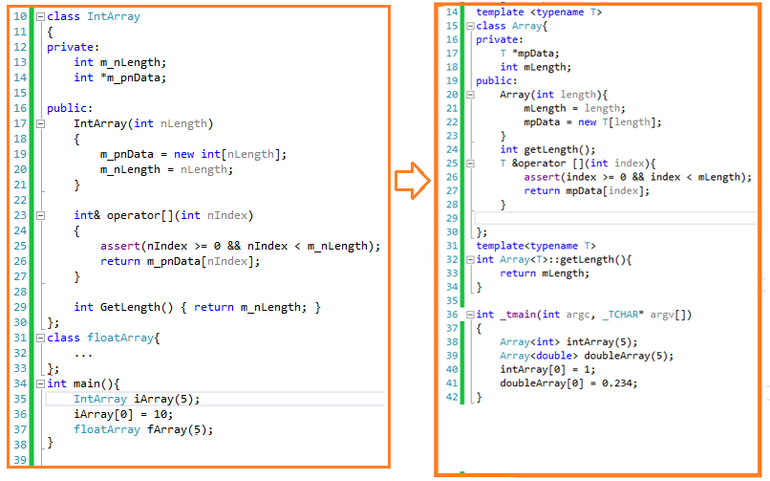
Example of Template classes

Slide 13
Expression parameter
A template expression parameter is a parameter that does not substitute for a type, but is instead replaced by a value
An expression parameter can be any of the following:
A value that has an integral type or enumeration
A pointer or reference to an object
A pointer or reference to a function
A pointer or reference to a class member function

Slide 14
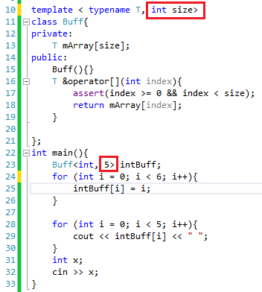
Example of expression parameter

Slide 15
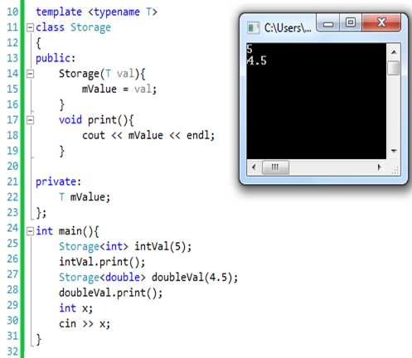
Template specialization
A particular member function will have the same implementation details for each instanced type. But template specialization lets you implement a templated member function slightly different for a specific data type.
Same

Slide 16
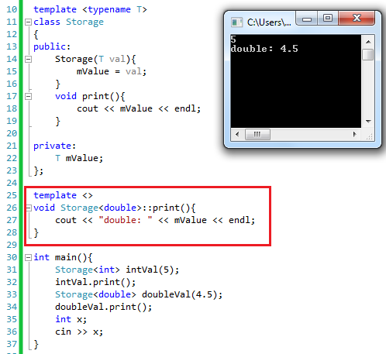
Template specialization
Different

Slide 17
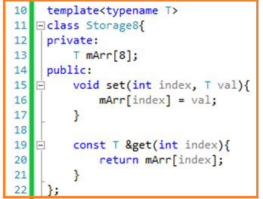
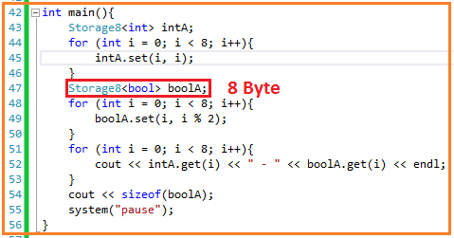
Class template specialization
Class template specialization allows us to specialize a template class for a particular data type

Slide 18
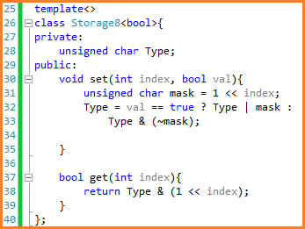
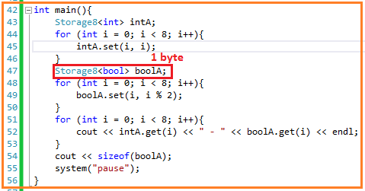
Class template specialization(cont)
With class template specialization we can create template specialization of bool version to reduce 8 -> 1 byte.

Slide 19
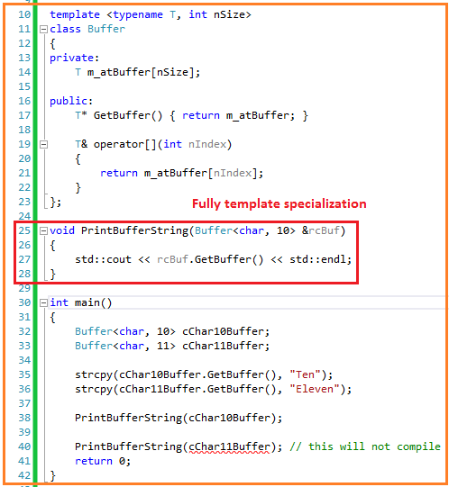
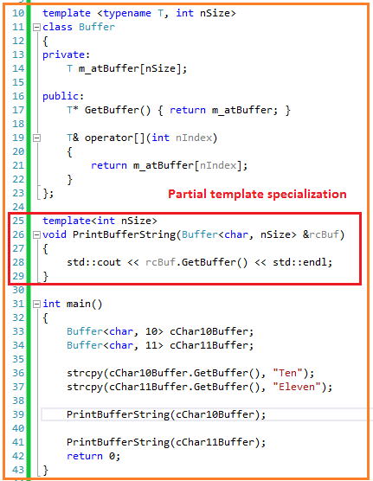
Partial template specialization
Allows us to write functions where some of the template parameters have been fully or partially resolved. Example:

Slide 20
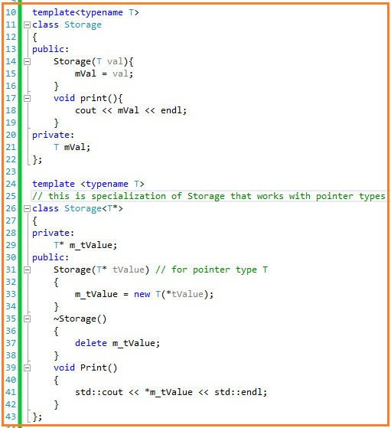
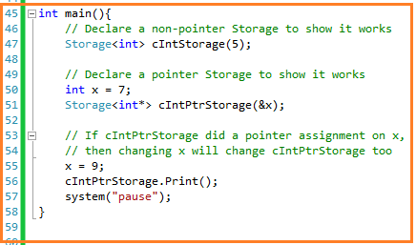
Example of Partial template specialization for pointers

Slide 21

Thanks for your attention!

